Slide 1
IEEE 802.15 STANDARD FOR WIRELESS PERSONAL AREA NETWORKS
ECE 525E – WIRELESS & MOBILE COMMUNICATION
Wednesday, 15 April 2026

Slide 2
WORKING GROUP 802.15 AND THE OTHER
IEEE WIRELESS STANDARDS AREAS
IEEE 802.15 Wireless Personal Area Network (WPAN) Working Group
IEEE 802.11
WLAN Working Group
IEEE 802.16
WMAN Working Group
Task Group 1
WPAN/Bluetooth™
Task Group 2
Coexistence
IEEE 802.18
Radio Regulatory TAG
Task Group 3a
WPAN Alt.
Higher Rate
IEEE 802.19
Coexistence TAG
Task Group 3
WPAN High Rate
IEEE 802.20
Mobile BWA Working Group
Task Group 4
WPAN Low Rate
IEEE 1451.5
Working Group
for Wireless Sensors

Slide 3
IEEE 802.15 STANDARD GOALS
IEEE 802.15 focuses on the development of consensus standards for Personal Area Networks or short distance wireless networks.
These WPANs address wireless networking of portable and mobile computing devices such as PCs, PDAs, peripherals, cell phones and consumer electronics.
The goal is to publish standards, recommended practices, or guides that have broad market applicability and deal effectively with the issues of coexistence and interoperability with other wired and wireless networking solutions.

Slide 4
802.15 WG is developing 3 MACs and 5 PHYs, TG3a is the 6th PHY
{
Service Specific
Convergence Sublayer
(SSCS)
Logical Link
Control Sublayer
{
Medium Access
Control Sublayer
{
Physical
Layer
= Other LLC
= Draft in process or complete
= Draft not defined e.g., CFP, etc.

Slide 5
BLUETOOTH
ECE 525E – WIRELESS & MOBILE COMMUNCATION
Friday, 20 August 2021

Slide 6
WHAT IS BLUETOOTH?
Bluetooth is a global, RF-based (S-BAND - ISM band: 2.4GHz), short-range, connectivity technology & solution for portable, personal devices
  it is not just a radio
  create piconets on-the-fly (appr. 1Mbps)
    piconets may overlap in time and space for high aggregate bandwidth
Bluetooth protocol operates at 2.4GHz in the same unlicensed ISM frequency band where RF protocols like ZigBee and WiFi.
The Bluetooth specification comprises:
  a hardware and software protocol specification
  usage case scenario profiles and interoperability requirements

Slide 7
BLUETOOTH ARCHITECTURE / 01
Communication
Bluetooth communication occurs between a master and a slave station. A slave can only connect to one master.
Bluetooth radios are symmetric in that the same device may operate as a master and also the slave.
Piconets
Two or more radio devices together form ad-hoc networks called piconets.
All units within a piconet share the same channel.
Each piconet has one master device and one or more slaves. There may be up to seven active slaves at a time within a piconet.
A device may be a master in one piconet and a slave in another or a slave in more than one piconet.
Scatternet
Multiple piconets with overlapping coverage areas form a scatternet.
Master
Slave
Bridge
Piconet 1
Piconet 2
(a) Scatternet

Slide 8
BLUETOOTH ARCHITECTURE / 02
Radio designation
  Connected radios can be master or slave
  Radios are symmetric (same radio can be master or slave)
Piconet
  Master can connect to 7 simultaneous or 200+ inactive (parked) slaves per piconet
  Each piconet has maximum channel capacity of 1 Mbps.
  Unique hopping pattern/ID
Scatternet
  High capacity system
  Minimal impact with up to 10 piconets within range
S
M
P
S
sb
S
P
P
sb
M
S

Slide 9
BLUETOOTH PICONET
  All devices in a piconet hop together
    To form a piconet: master gives slaves its clock and device ID
      Hopping pattern determined by device ID (48-bit)
    Phase in hopping pattern determined by Clock
  Non-piconet devices are in standby
Piconet Addressing
    Active Member Address (AMA, 3-bits), i.e Master and 2³-1 = 7 slave devices
    Parked Member Address (PMA, 8-bits), i.e Master + 2⁸-1 = 255 Parked devices

Slide 10
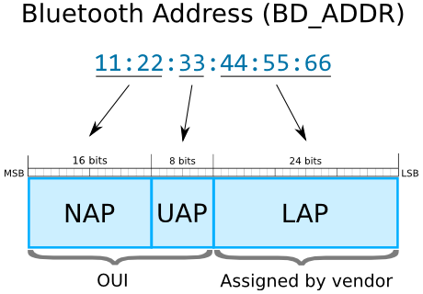
BLUETOOTH NAMES & ADDRESSES
Every single Bluetooth device has a unique 48-bit address, commonly abbreviated BD_ADDR.
BD_ADDR is usually displayed as 6 bytes written in hexadecimal and separated by colons e.g. 00:11:22:33:FF:EE.
The most-significant half (24 bits) of the address is an Organization Unique Identifier (OUI), which identifies the manufacturer and are assigned by IEEE.
The lower 24-bits are the more unique part of the address.
Lower Address Part
Non-significant Address Part

Slide 11
BLUETOOTH ADDRESSING (BD_ADDR)
NAP
Non-significant Address Part (2 bytes). Contains first 16 bits of the OUI. The NAP value is used in Frequency Hopping Synchronization frames
UAP
Upper Address Part (1 byte) is used for seeding in various Bluetooth specification algorithms.
LAP
Lower Address Part (3 bytes) uniquely identifies a Bluetooth device as part of the Access Code in every transmitted frame.

Slide 12
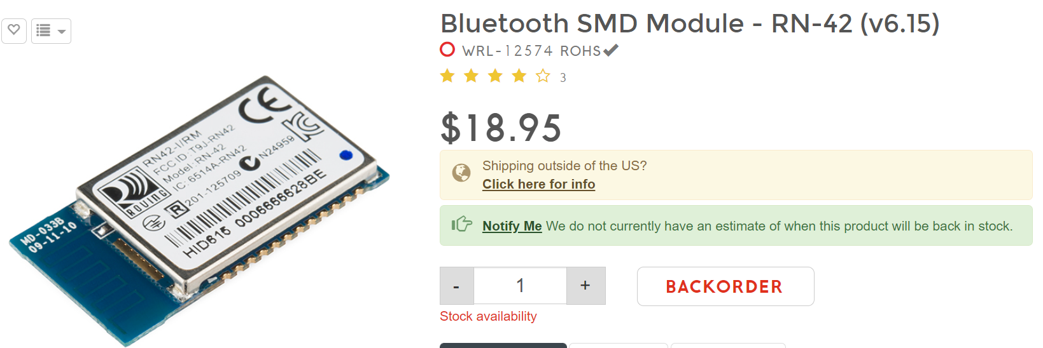
MAC ADDRESS OF BLUETOOTH DEVICES
Most Bluetooth devices have the MAC address clearly labeled.
For example, on this RN-42 Bluetooth Module, the address printed next to "MAC NO." is 00066666628BE:

Slide 13
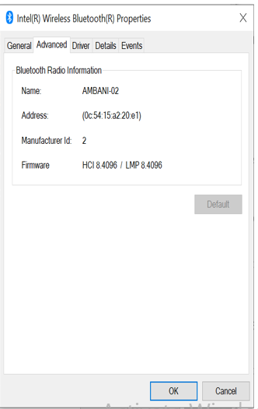
BLUETOOTH USER FRIENDLY NAMES
Bluetooth devices also have user-friendly names given to them for easy identification.
The rules for device names are less stringent.
They can be up to 248 bytes long.
Two devices can share the same name.

Slide 14
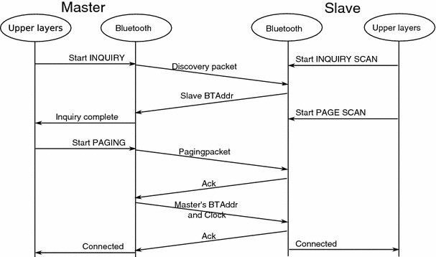
BLUETOOTH CONNECTION PROCESS
Creating a Bluetooth connection between two devices is a multi-step process involving three progressive states:
Inquiry: If two Bluetooth devices know absolutely nothing about each other, one must run an inquiry to try to discover the other. One device sends out the inquiry request, and any device listening for such a request will respond with its address, and possibly its name and other information.
Paging (Connecting): Paging is the process of forming a connection between two Bluetooth devices. Before this connection can be initiated, each device needs to know the address of the other (found in the inquiry process).
Connection: After a device has completed the paging process, it enters the connection state. While connected, a device can either be actively participating or it can be put into a low power sleep mode

Slide 15
BLUETOOTH CONNECTION MODES
While connected, a device can either be actively participating or it can be put into a low power sleep mode.
Active Mode: Regular connected mode, where the device is actively transmitting or receiving data.
Sniff Mode: Power-saving mode, where the device is less active. It'll sleep and only listen for transmissions at a set interval (e.g. every 100ms).
Hold Mode: A temporary, power-saving mode where a device sleeps for a defined period and then returns back to active mode after some interval. The master can command a slave device to hold.
Park Mode: The deepest of sleep modes. A master can command a slave to "park", and that slave will become inactive until the master tells it to wake back up.

Slide 16
HOW TO FIND BLUETOOTH BD_ADDR IN WINDOWS /01
Follow the following steps to find Bluetooth MAC Address in Windows:
Click the Bluetooth icon in the system tray and select "Open Settings".
Select "Bluetooth and Other Devices"
Select “More Bluetooth Options".
In the "Bluetooth Radio Properties" form go to "Advanced" tab.

Slide 17
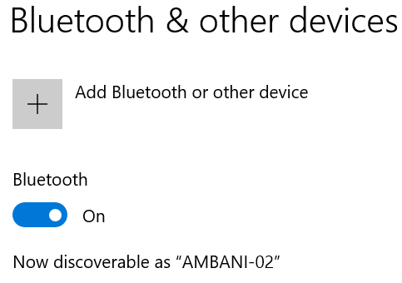
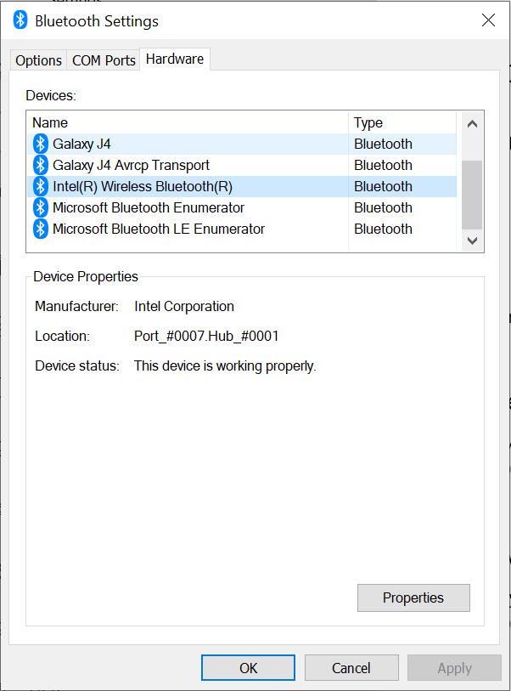
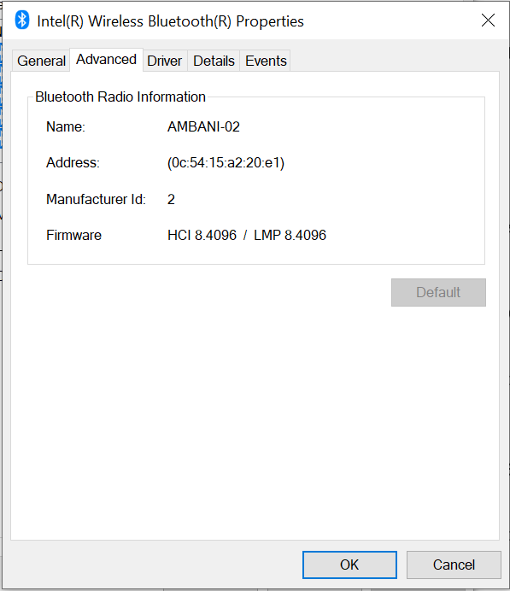
HOW TO FIND BLUETOOTH BD_ADDR IN WINDOWS /02

Slide 18
BLUETOOTH BASESBAND PROTOCOL
Standby
  Waiting to join a piconet
Inquire
  Ask about radios to connect to
Page
  Connect to a specific radio
Connected
  Actively on a piconet (master or slave)
Park/Hold
  Low-power connected states
Unconnected:
Standby
Standby
Detach
Connecting
states
Inquiry
Page
T =2s
tpcl
T =0.6s
tpcl
Active
states
Transmit
Connected
data
AMA
AMA
T =2ms
T =2ms
tpcl
tpcl
Low-power
states
PARK
HOLD
PMA
AMA
releases
AMA address
AMA – Active Member Address

Slide 19
BLUETOOTH INQUIRE PROCEDURE
Paging radio issues page packet with Inquire ID
Any radio doing an Inquire scan will respond with an FHS packet
  FHS packet gives Inquiring radio information to page
    Device ID
    Clock
  If there is a collision then radios wait a random number of slots before responding to the page inquire
After process is done, Inquiring radio has Device IDs and Clocks speeds of all radios in range

Slide 20
BLUETOOTH RADIO INTERFACE
frequency synthesis: frequency hopping
  2.402 + k MHz, k=0, …, 78
  1,600 hops per second
conversion bits into symbols: modulation
  GFSK (BT = 0.5; 0.28 < h < 0.35);
  1 MSymbols/s
transmit power
  0 dbm to 20dbm with power control
receiver sensitivity
  -70dBm @ 0.1% BER

Slide 21
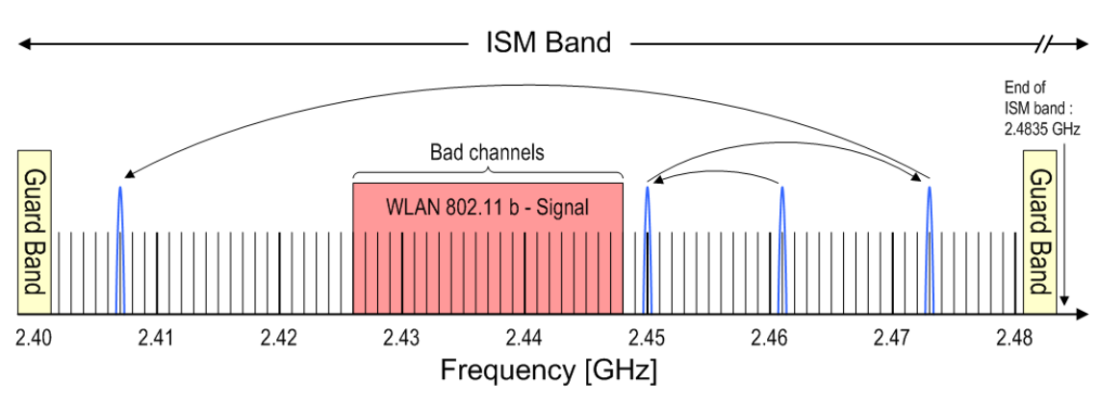
BLUETOOTH FREQUENCY HOPPING
Spread spectrum frequency hopping radio
  79/23 one MHz channels
  Hops every packet
    Packets are 1, 3 or 5 slots long
  Frame consists of two packets
    Transmit followed by receive
  Nominally hops at 1600 times a second (1 slot packets)

Slide 22
BLUETOOTH SECURITY FEATURES / 01
Fast frequency hopping (79 channels)
Low transmit power (range <= 10m)
Authentication of remote device
  based on link key (128 Bit)
  May be performed in both directions
Encryption of payload data
  Stream cipher algorithm (≤ 128 Bit)
  Affects all traffic on a link
Authentication/Initialization
  PIN entry by user

Slide 23
BLUETOOTH SECURITY FEATURES / 02
Link keys are generated via a PIN entry
A different link key for each pair of devices is allowed
Authentication:
  Challenge-Response Scheme
Permanent storage of link keys
K_{AD}
D
A
K_{MA}
K_{MD}
M
K_{MB}
K_{MC}
B
C

Slide 24
KEY GENERATION & USAGE
PIN
PIN
User Input
(Initialization)
E₂
E₂
Authentication
(possibly)
Permanent
Storage
Link Key
Link Key
E₃
E₃
Encryption
Temporary
Storage
Encryption Key
Encryption Key

Slide 25
BLUETOOTH POWER MANAGEMENT
Standby current < 0.3 mA
  3 months(*)
Voice mode 8-30 mA
  75 hours
Data mode average 5 mA
(0.3-30mA, 20 kbps, 25%)
  120 hours
Low-power architecture
  Programmable data length (else radio sleeps)
  Hold and Park modes: 60 µA
    Devices connected but not participating
    Hold retains Active Member address (AMA), Park releases AMA, gets PMA address
    Device can participate within 2 ms
(*)Estimates calculated with 600 mAh battery and internal amplifier, power will vary with implementation

Slide 26
BLUETOOTH POWER CLASSES
Different applications of Bluetooth require different power levels which also affects the range.
The transmit power, and by extension range, of a Bluetooth module is defined by its power class.
There are three defined classes of Bluetooth power:
Class Number | Max Output Power (dBm) | Max Output Power (mW) | Max Range
Class 1 | 20 dBm | 100 mW | 100 m
Class 2 | 4 dBm | 2.5 mW | 10 m
Class 3 | 0 dBm | 1 mW | 10 m

Slide 27
TYPICAL(TEXTBOOK) FEATURES OF BLUETOOTH

Slide 28



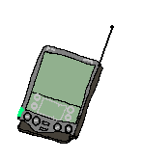




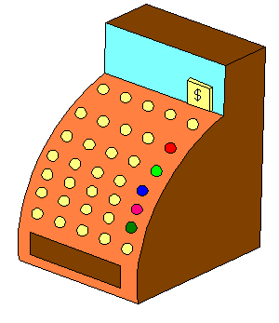
BLUETOOTH APPLICATIONS
Landline
Cable Replacement
Data/Voice Access Points
Personal Ad-hoc Networks

